Slide 1


SUICIDAL TENDENCY DETECTION USING MACHINE LEARNING
under the esteemed guidance of,
B. JYOSTHNA
Assistant Professor ,CSE Department.
presented by,
19KN1A05A3 -M.Tejaswini
19KN1A05B9 - M.Ajay
19KN1A05B6 - Md.Abdul Wajid

Slide 2
CONTENTS:
Abstract
Introduction
What is a suicidal tendency
Objective
Existing System
Drawbacks of the existing system
Proposed System
Advantages
Hardware and software requirements
UML Diagrams
Raw Dataset
Code
Output
Conclusion

Slide 3
ABSTRACT:
Suicidal Tendency or the intention to kill oneself or end one’s life is a catastrophic situation that is mostly unknown by any person in the victim’s life.
Suicide has been an intractable public health problem despite advances in the diagnosis and treatment of major mental disorders.
In many studies, it is clearly evident that victims tend to kill themselves either to end their pain or pressure or to have a sense of relief that they are not going to live in this world anymore.
This project aims to propose a method that helps the family, friends or the close ones of the victim to immediately detect if the person has already started feeling the sense of depression.
The main aim is to find a strong co-relation between components in the subsystem and compare the accuracies to build an alarming system
Unlike the existing systems, this project aims to detect the suicidal tendencies in multiple aspects instead of focusing on a single perspective.

Slide 4

INTRODUCTION:
This project aims to focus on people who have the intention to kill themselves.
In this consequence, a multi-faceted method that can detect this tendency and intimate the family, friends, or close ones beforehand can prove to be a boon for the invention.
This project tends to consider an electronic device, particularly a mobile (as used by most of them) as the key element.
This device is used to capture different elements like facial gestures, speech recognition, etc.

Slide 5

OBJECTIVE:
The objective of this system is that it is capable of detecting suicidal tendencies in a specific person. Unlike other existing systems this system can ensure the ability to focus on different technical aspects rather than a single one.
The project aims to find a correlation between the three components present below.
1. Facial Gesture Detection – Human-Computer Interaction
2. Speech Recognition – Natural Language Processing
3. Messaging Patterns – Text Tokenization through NL

Slide 6
EXISTING SYSTEM:
Since suicide is not a decision made up in a single day, much research had been done in the past on various aspects. While some of them included how suicides occur and others concluded with some methodologies on how to detect suicidal intentions.
Distinct approaches using Human-Computer Interaction, Natural Language Processing, and using Convolutional Neural Networks were highly popular.
But these systems possessed a drawback in that, it was not practically possible to indicate a clear demarcation in only one aspect of implementation.

Slide 7
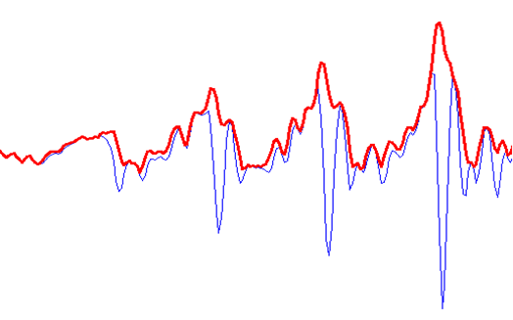
DRAWBACKS OF EXISTING SYSTEM:
Can predict outcomes only from one aspect.
The output is not reliable

Slide 8
PROPOSED SYSTEM:
This project aims to propose a system that is capable of detecting suicidal tendencies using multiple approaches.
Three technologies namely Human-Computer Interaction, Natural Language Processing, and voice pattern analysis are taken into consideration to perform a detailed execution.
Later a correlation matrix is proposed to be implemented that is able to find strong or weak correlations between the above three components.

Slide 9
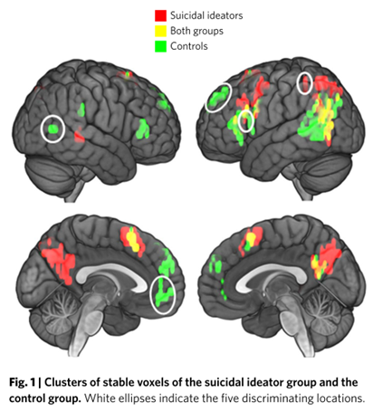
ADVANTAGES:
Predicts outcomes from multiple aspects.
Reliable outcome due to correlation matrix

Slide 10
SYSTEM REQUIREMETS:
Software Requirements :
Operating System – Windows 10
IDE - Visual Studio Code or PyCharm
Database - SQLite
Language – Python 3.7.0
Hardware Requirements :
Processor - An Intel Pentium 4 processor or above
Hard Drive Space - 100GB & above
RAM - 4GB (Min)

Slide 11
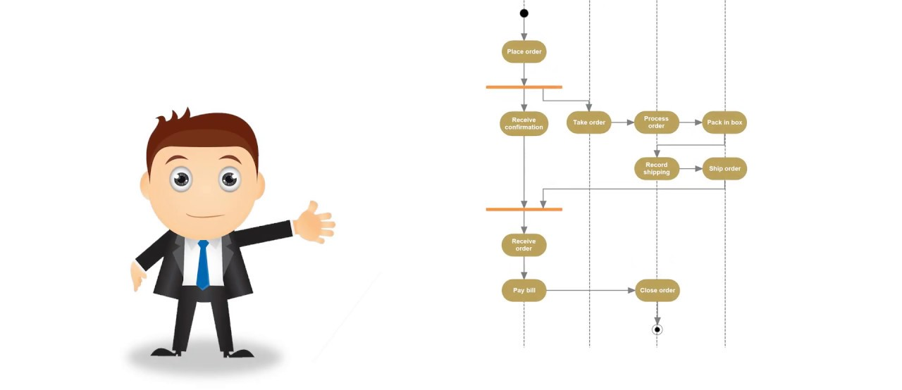
UML DIAGRAMS

Slide 12
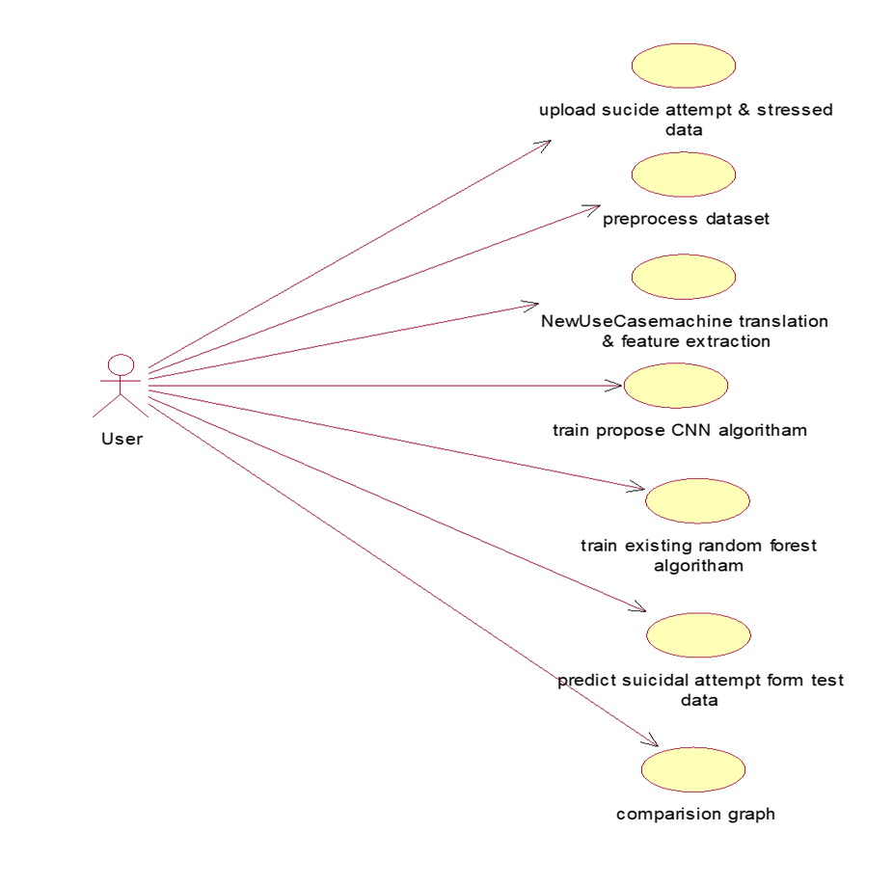
USECASE DIAGRAM:

Slide 13
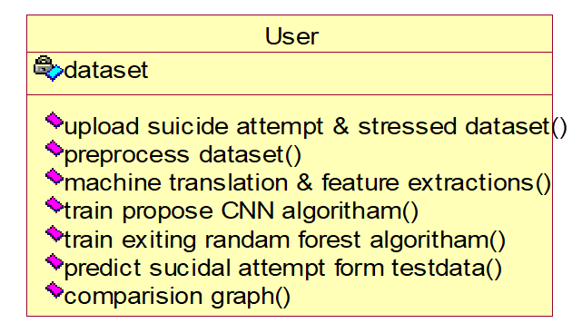
CLASS DIAGRAM:

Slide 14
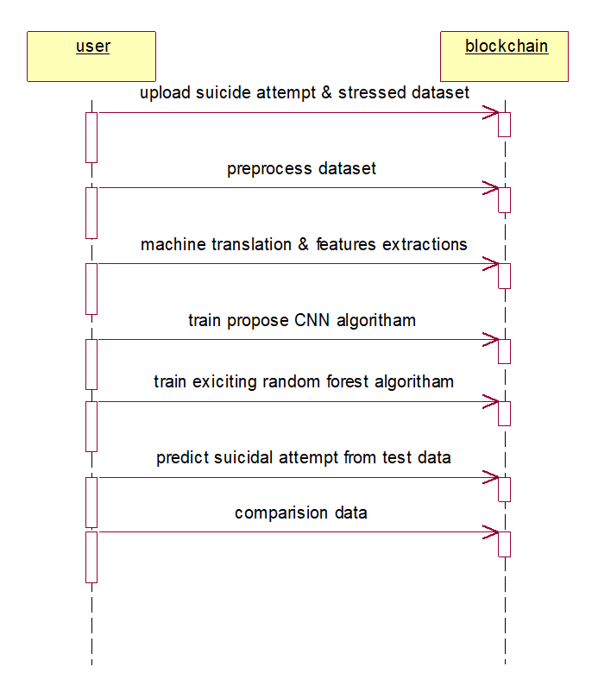
SEQUENCE DIAGRAM:

Slide 15
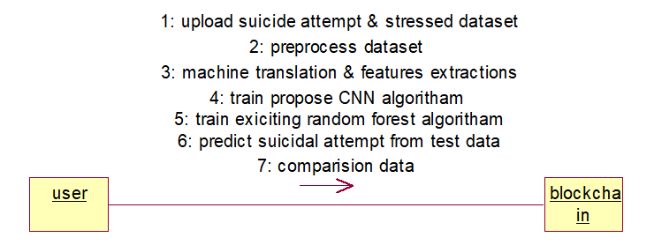
COLLABORATION DIAGRAM:

Slide 16
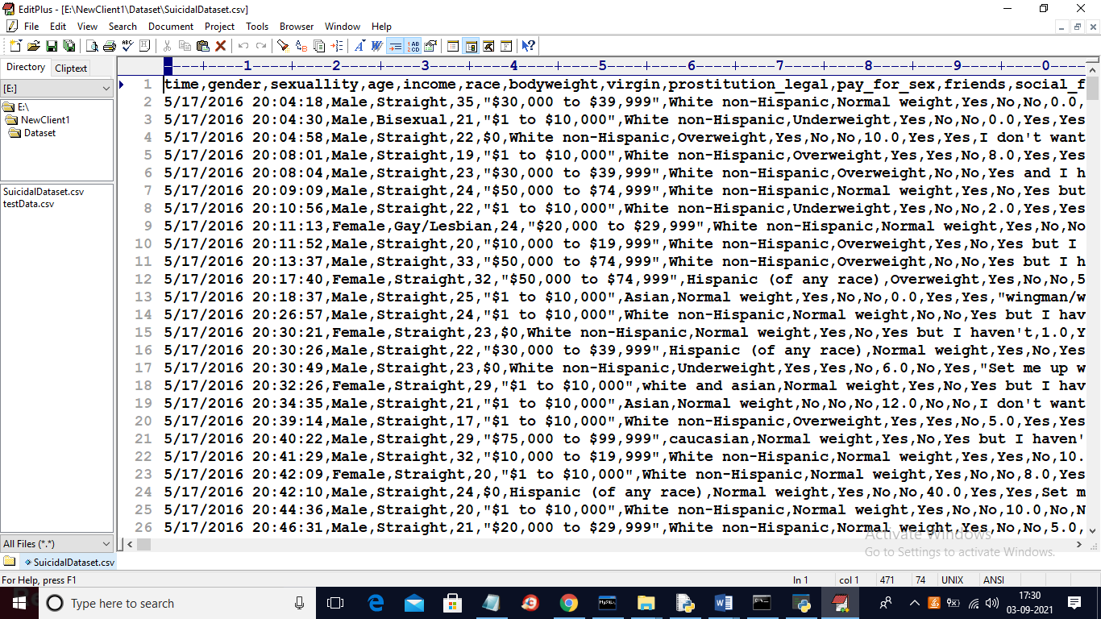
RAW DATASET:

Slide 17
PROJECT CODE : Libraries:
import numpy as np
import matplotlib.pyplot as plt from sklearn.preprocessing import normalize
from sklearn.ensemble import RandomForestClassifier
from sklearn.preprocessing import normalize
from sklearn.metrics import precision_score
from sklearn.metrics import recall_score
from sklearn.metrics import f1_score
from sklearn.metrics import accuracy_score
import pandas as pd
from keras.utils.np_utils import to_categorical

Slide 18
Pre-process:
def processDataset():
global X,Y
global dataset
text.delete('1.0', END)
label = dataset.groupby('attempt_suicide').size()
label.plot(kind="bar")
dataset.fillna(0, inplace = True)
text.insert(END,"All missing values are replaced with 0\n")
text.insert(END,"Total processed records found in dataset : "+str(dataset.shape[0])+"\n\n")
plt.show()

Slide 19
Translation:
def translation():
global X_train, X_test, y_train, y_test
global X,Y
global le
global dataset
text.delete('1.0', END) dataset.drop(['time'], axis = 1,inplace=True)
dataset.drop(['income'], axis = 1,inplace=True)
Y = dataset.values[:,2]
cols=['gender','sexuallity','race','bodyweight','virgin','prostitution_legal’,
'pay_for_sex','social_fear','stressed','what_help_from_others','attempt_suicid e','employment','job_title','edu_level','improve_yourself_how']
le = LabelEncoder()
for i in range(15):
dataset[cols[i]] = pd.Series(le.fit_transform(dataset[cols[i]].astype(str)))
text.insert(END,"Dataset after applying machine translation\n\n")
text.insert(END,str(dataset)+"\n\n")
Y = dataset.values[:,12]
print(Y)

Slide 20
Train CNN: def trainCNN(): XX = X.reshape(X.shape[0],X.shape[1],1,1) YY = to_categorical(Y) X_train1 =X_train.reshape(X_train.shape[0],X_train.shape[1],1,1) X_test1 = X_test.reshape(X_test.shape[0],X_test.shape[1],1,1) y_train1 = to_categorical(y_train) y_test1 = to_categorical(y_test) classifier = Sequential() classifier.add(Convolution2D(32, 1, 1, input_shape = (X_train1.shape[1], X_train1.shape[2], X_train1.shape[3]), activation = 'relu')) classifier.add(MaxPooling2D(pool_size = (1, 1))) classifier.add(Convolution2D(32, 1, 1, activation = 'relu')) classifier.add(MaxPooling2D(pool_size = (1, 1))) classifier.add(Flatten()) classifier.add(Dense(output_dim = 256, activation = 'relu')) classifier.add(Dense(output_dim = y_train1.shape[1], activation = 'softmax')) print(classifier.summary()) classifier.compile(optimizer = 'adam', loss = 'categorical_crossentropy', metrics = ['accuracy']) hist = classifier.fit(XX, YY,batch_size=16, epochs=70, shuffle=True, verbose=2) predict = classifier.predict(X_test1) a = accuracy_score(y_test1,predict)*100 p = precision_score(y_test1, predict,average='macro') * 100 r = recall_score(y_test1, predict,average='macro') * 100 f = f1_score(y_test1, predict,average='macro') * 100 accuracy.append(a) precision.append(p) recall.append(r) fscore.append(r)

Slide 21
Random Forest algorithm:
def RFTraining():
global accuracy
global X_train, X_test, y_train, y_test
global X,Y
rf = RandomForestClassifier(class_weight='balanced')
rf.fit(X_train,y_train)
predict = rf.predict(X_test)
a = accuracy_score(y_test,predict)*100
p = precision_score(y_test, predict,average='macro') * 100
r = recall_score(y_test, predict,average='macro') * 100
f = f1_score(y_test, predict,average='macro') * 100
accuracy.append(a)
precision.append(p)
recall.append(r)
fscore.append(r)
text.insert(END,"Existing Random Forest Accuracy on Test Data :"+st r(a)+"\n")
text.insert(END,"Existing Random Forest Precision on Test Data : "+str(p)+"\n")

Slide 22
Prediction:
def predict():
global classifier
text.delete('1.0', END)
filename = filedialog.askopenfilename(initialdir="Dataset")
testData = pd.read_csv(filename)
temp = testData.values
testData.fillna(0, inplace = True)
testData.drop(['time'], axis = 1,inplace=True)
testData.drop(['income'], axis = 1,inplace=True)
cols = ['gender','sexuallity','race','bodyweight','virgin','prostitution_legal','pay_for_se x','social_fear','stressed','want_help_from_others','employment','job_title','edu_le vel','improve_yourself_how’]
testData = testData.values
testData = testData.reshape(testData.shape[0],testData.shape[1],1,1)
#testData = normalize(testData)
predict = classifier.predict(testData)
predict = np.argmax(predict, axis=1)
print(predict)

Slide 23
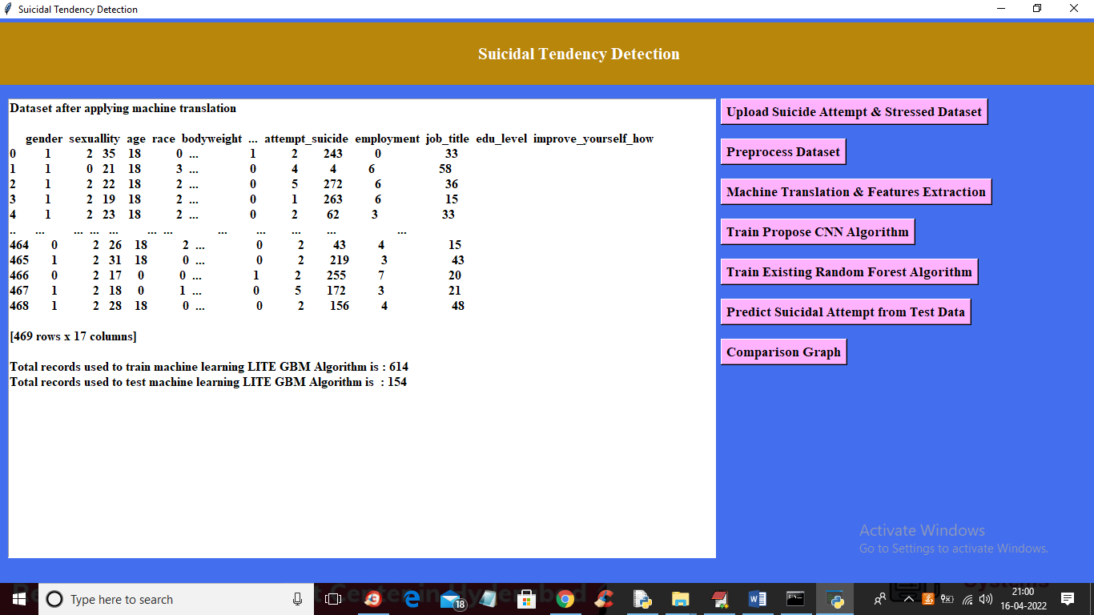
OUTPUT: CNN ALGORITHM TRAINING
In above screen we can see complete dataset is translated to numeric data and in below two lines we can see dataset using 614 records to train CNN algorithms and using 154 records for testing CNN performance. Now train and test data is ready and now click on ‘Train Propose CNN Algorithm’ button to train CNN with above dataset and to get below output

Slide 24
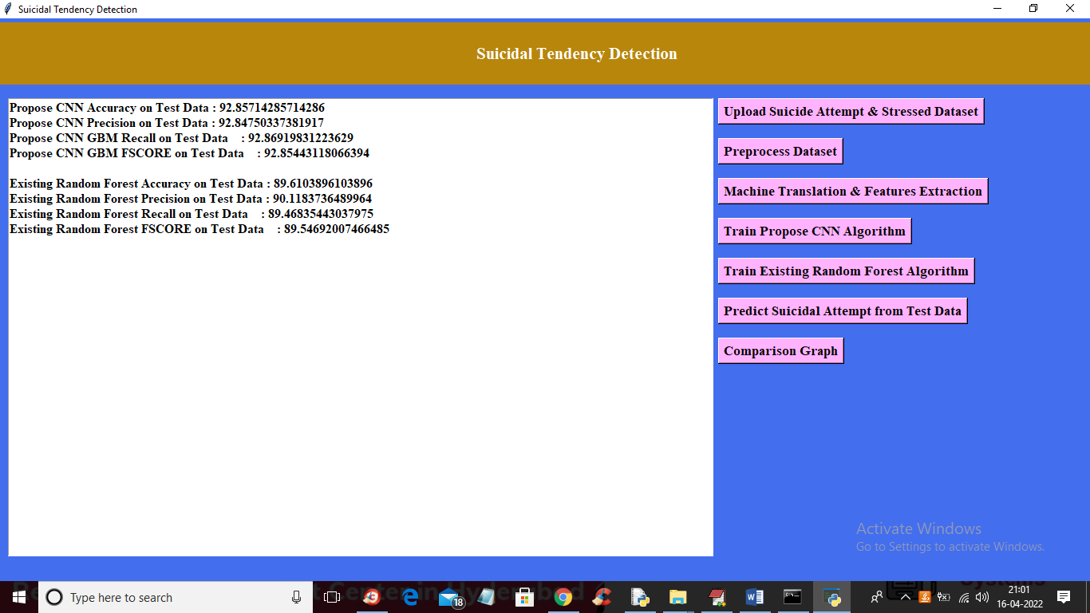
RANDOM FOREST TRANING:
In above screen with existing random forest algorithm we got 89% accuracy and now click on ‘Predict Suicidal Attempt from Test Data’ button to upload test data and then CNN will predict whether test patient records has any suicidal and NO suicidal thoughts.

Slide 25
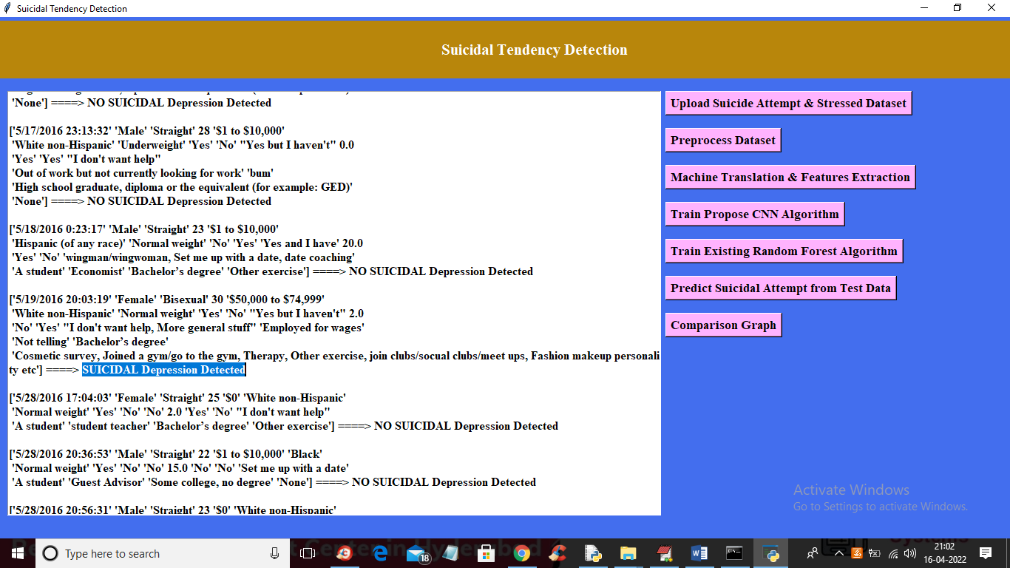
TESTING:

Slide 26
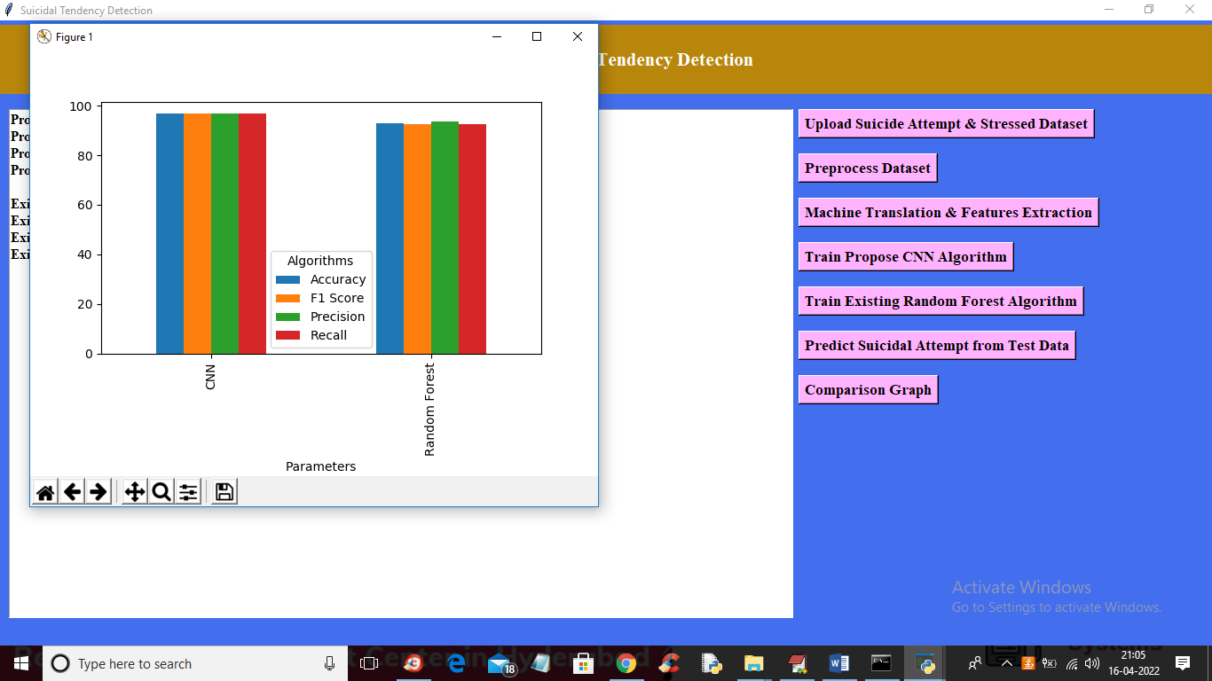
COMPARISON GRAPH:
In above graph x-axis represents algorithm names and y-axis represents accuracy, precision, recall and FSCORE in different colour bars. In above graph we can see CNN is performing well compare to existing Random Forest algorithm.

Slide 27

CONCLUSION:
Suicide prevention remains an essential task in our modern society. Early detection of suicidal ideation is an important and effective way to prevent suicide.
This survey investigates existing methods for suicidal ideation detection from a broad perspective which covers clinical methods like patient-clinician interaction and medical signal sensing; textual content analysis such as lexicon-based filtering and word cloud visualization; feature engineering including tabular, textual, and effective features; and deep learning-based representation learning like CNN- and LSTM-based text encoders.
Four main domain-specific applications on questionnaires, EHR are introduced.

Slide 28


